Slide 1
Waveform Optimisation for Information and Power Transfer
Waveform Optimisation for Information and Power Transfer
15 Feb. 19
The Nonlinear Harvester Model and Rate-Energy Tradeoff
Yang Zhao (yang.zhao18@imperial.ac.uk)

Slide 2

Wireless Information and Power Transfer (WIPT)
Waveform Optimisation for Information and Power Transfer
15 Feb. 19
Topics
Energy harvest models (linear, nonlinear)
Rate-energy (R-E) region characterisation
Transmitter and receiver architecture
Waveform design
Modulation
Beamforming and input distribution
Resource allocation
RF spectrum use
“A WIPT system should therefore be designed such that the RF radiation and the RF spectrum are exploited in the most efﬁcient manner to deliver both information and energy.”
B. Clerckx et al, "Fundamentals of Wireless Information and Power Transfer: From RF Energy Harvester Models to Signal and System Designs," in IEEE Journal on Selected Areas in Communications, vol. 37, no. 1, pp. 4-33, Jan. 2019.
Image by IoT connection. Adapted from IoT Services and Solutions provider for Business, by Credencys Solutions Inc., 2019, retrieved from https://www.credencys.com/iot-solutions/. Copyright by Credencys Solutions Inc.

Slide 3
Waveform Optimisation
Waveform Optimisation for Information and Power Transfer
15 Feb. 19
Why?
Where?
To enlarge the R-E region
To improve spectrum and power efficiency
To support numerous low-power devices
To boost the revolution in IoT
Channel (adaptive signal based on CSIT to enhance rate)
Receiver (suitable waveform favoured by rectenna to maximise energy)
What?
How?
Identify the fundamental tradeoff between information and power transfer
Evaluate linear and nonlinear harvest models
Investigate beamforming, power allocation, waveform, modulation, and input distribution
Formulate the optimisation problem as an energy maximisation problem
Superpose a deterministic power waveform to a communication waveform
Twofold benefit: energy (multisine > modulated), rate (deterministic, no interference)

Slide 4
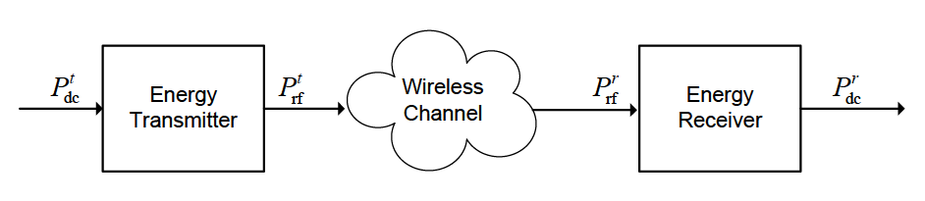
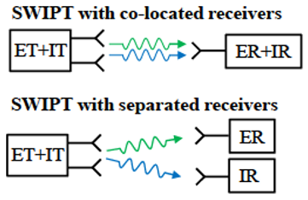
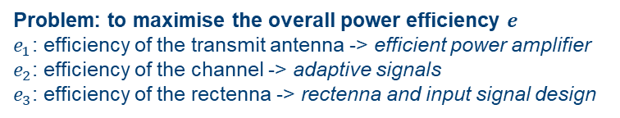

SWIPT Diagram
Waveform Optimisation for Information and Power Transfer
15 Feb. 19
Blocks of WIPT system
$e=\frac{P_{dc}^{r}}{P_{dc}^{t}}=\frac{P_{rf}^{t}}{P_{dc}^{t}}$ $\frac{P_{rf}^{r}}{P_{rf}^{t}}$ $\frac{P_{dc}^{r}}{P_{rf}^{r}}=e_{1}e_{2}e_{3}$
Problem: to maximise the overall power efficiency $e$
$e_{1}$: efficiency of the transmit antenna -> efficient power amplifier
$e_{2}$: efficiency of the channel -> adaptive signals
$e_{3}$: efficiency of the rectenna -> rectenna and input signal design
Simultaneous WIPT
Diode linear model: $e_{1}$ and $e_{3}$ are independent of input signal power and shape (optimise $e_{1}$, $e_{2}$, $e_{3}$separately)
Diode nonlinear model: $e_{1}$, $e_{2}$, $e_{3}$ are coupled, $e_{3}$ is a nonlinear function of the input signal (jointly optimise $e_{2}e_{3}$)
B. Clerckx et al, "Fundamentals of Wireless Information and Power Transfer: From RF Energy Harvester Models to Signal and System Designs," in IEEE Journal on Selected Areas in Communications, vol. 37, no. 1, pp. 4-33, Jan. 2019.

Slide 5
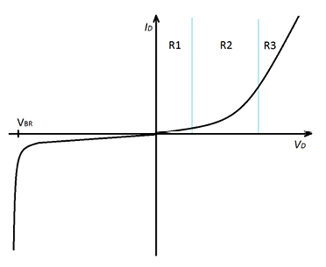
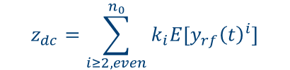
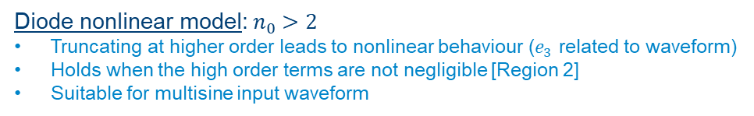

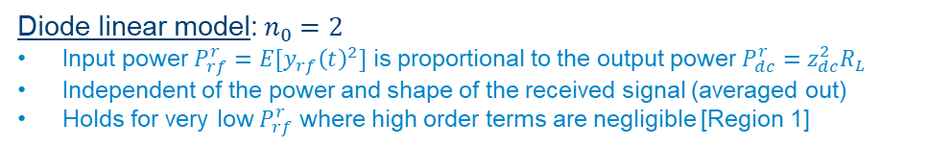

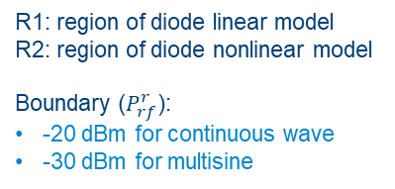
Diode Nonlinearity and Harvester Models
Waveform Optimisation for Information and Power Transfer
15 Feb. 19
Diode DC current (determines output power):
$$z_{dc}=\sum_{i≥2, even}^{n_{0}}{k_{i}E[{y_{rf}\left(t\right)}^{i}]}$$
Diode linear model:${ n}_{0} =2$
Input power $P_{rf}^{r}=E[{y_{rf}\left(t\right)}^{2}]$ is proportional to the output power $P_{dc}^{r}=z_{dc}^{2}R_{L}$
Independent of the power and shape of the received signal (averaged out)
Holds for very low $P_{rf}^{r}$ where high order terms are negligible [Region 1]
Diode characteristics
R1: region of diode linear model
R2: region of diode nonlinear model
Boundary ($P_{rf}^{r}$):
-20 dBm for continuous wave
-30 dBm for multisine
Diode nonlinear model:${ n}_{0} >2$
Truncating at higher order leads to nonlinear behaviour ($e_{3}$ related to waveform)
Holds when the high order terms are not negligible [Region 2]
Suitable for multisine input waveform
B. Clerckx et al, "Fundamentals of Wireless Information and Power Transfer: From RF Energy Harvester Models to Signal and System Designs," in IEEE Journal on Selected Areas in Communications, vol. 37, no. 1, pp. 4-33, Jan. 2019.
Diode current and DC current:
$$i_{d}\left(t\right)=\sum_{i=0}^{∞}{k_{i}^{′}R_{ant}^{\frac{i}{2}}y_{rf}{(t)}^{i}}$$
$$i_{out}=E\left[i_{d}\left(t\right)\right]$$

Slide 6
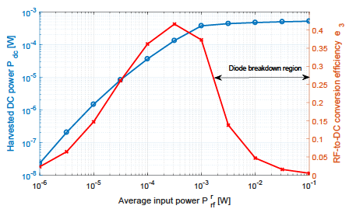
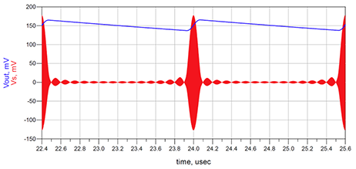


Multisine and Efficiency
Waveform Optimisation for Information and Power Transfer
15 Feb. 19
Multisine waveform:
High peak-to-average power ratio (PAPR)
Concentrated power triggers the diode
Pulse amplitude determined by number of tones N
Harvested DC power $P_{dc}^{r}$ vs average input power $P_{rf}^{r}$and RF-to-DC conversion efﬁciency $e_{3}$
Multisine waveform used as a voltage source $v_{s}$ and the rectiﬁed output voltage $v_{out}$
B. Clerckx, “Wireless Information and Power Transfer: Nonlinearity, Waveform Design and Rate-Energy Tradeoff,” IEEE Trans. on Sig. Proc., vol 66, no 4, pp 847-862, Feb. 2018.
The larger the number of tones N, the larger is the magnitude of the pulses and therefore the larger is the output voltage at the time of discharge.

Slide 7
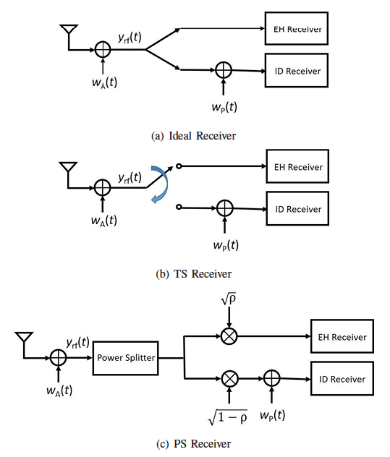
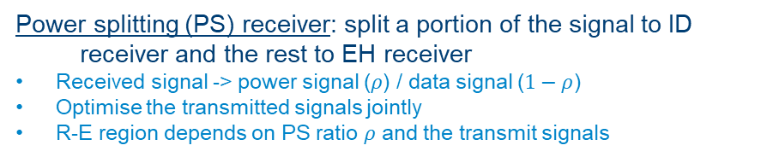
Receiver Architectures
Waveform Optimisation for Information and Power Transfer
15 Feb. 19
EH:
energy harvester
ID:
information decoder
Ideal receiver: use the same signal for both ID and EH receivers
Optimal but not realisable
Time switching (TS) receiver: switch the signal to either ID or EH receiver
Transmission block -> power block / data block (orthogonal)
Optimise waveforms for individual blocks
R-E tradeoff depends on slot length and the transmit signals
Power splitting (PS) receiver: split a portion of the signal to ID receiver and the rest to EH receiver
Received signal -> power signal ($ρ$) / data signal ($1−ρ$)
Optimise the transmitted signals jointly
R-E region depends on PS ratio $ρ$ and the transmit signals
Ideal, TS and PS receivers
B. Clerckx et al, "Fundamentals of Wireless Information and Power Transfer: From RF Energy Harvester Models to Signal and System Designs," in IEEE Journal on Selected Areas in Communications, vol. 37, no. 1, pp. 4-33, Jan. 2019.

Slide 8
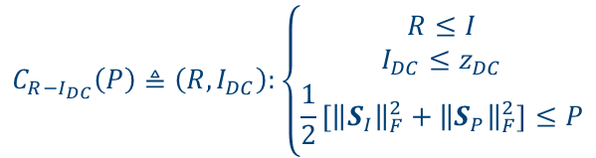
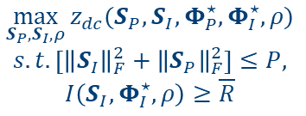
Problem Formulation
Waveform Optimisation for Information and Power Transfer
15 Feb. 19
The R-E region is defined as:
The optimisation problem turns into an energy maximisation problem:
$$C_{R−I_{DC}}\left(P\right)≜\left({R,I}_{DC}\right):\left\{\begin{aligned}R≤I \\ I_{DC}≤z_{DC} \\ \frac{1}{2}\left[{\left\|S_{I}\right\|}_{F}^{2}+{\left\|S_{P}\right\|}_{F}^{2}\right]≤P\end{aligned}\right.$$
$$\max_{{S_{P},S}_{I},ρ}{z_{dc}({S_{P},S}_{I},Φ_{P}^{⋆},Φ_{I}^{⋆},ρ)}$$
$$s.t.\left[{\left\|S_{I}\right\|}_{F}^{2}+{\left\|S_{P}\right\|}_{F}^{2}\right]≤P,$$
$$I\left(S_{I},Φ_{I}^{⋆},ρ\right)≥\overline{R}$$
Rate does not exceed mutual information
Output current is no larger than diode DC current
Resource spent on energy and information components no more than budget
… and can be transformed to Geometric Program then solved by the algorithms proposed by the paper
B. Clerckx, “Wireless Information and Power Transfer: Nonlinearity, Waveform Design and Rate-Energy Tradeoff,” IEEE Trans. on Sig. Proc., vol 66, no 4, pp 847-862, Feb. 2018.

Slide 9
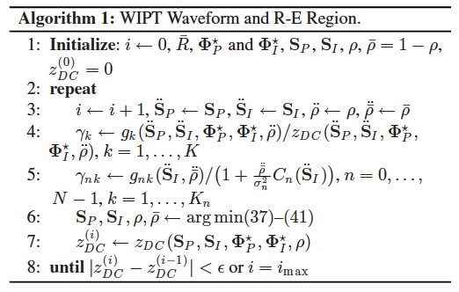
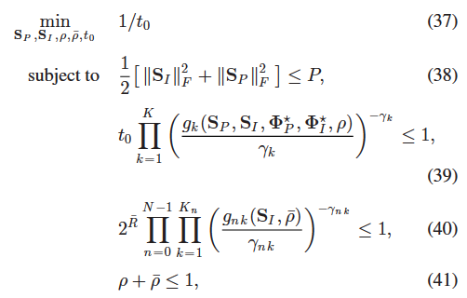
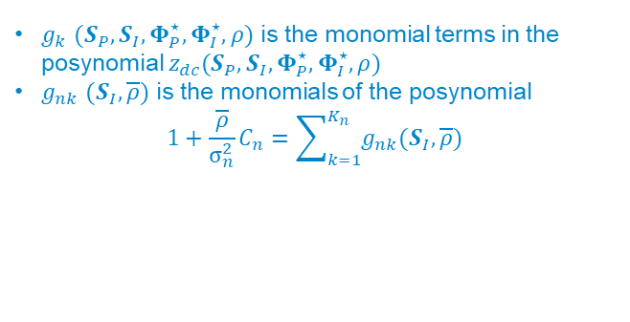
Algorithm: Single-Input
Waveform Optimisation for Information and Power Transfer
15 Feb. 19
$g_{k}$ $({S_{P},S}_{I},Φ_{P}^{⋆},Φ_{I}^{⋆},ρ)$ is the monomial terms in the posynomial $z_{dc}({S_{P},S}_{I},Φ_{P}^{⋆},Φ_{I}^{⋆},ρ)$
$g_{nk}$ $(S_{I},\overline{ρ})$ is the monomials of the posynomial
$$1+\frac{\overline{ρ}}{σ_{n}^{2}}C_{n}=\sum_{k=1}^{K_{n}}{g_{nk}(S_{I},\overline{ρ})}$$
B. Clerckx, “Wireless Information and Power Transfer: Nonlinearity, Waveform Design and Rate-Energy Tradeoff,” IEEE Trans. on Sig. Proc., vol 66, no 4, pp 847-862, Feb. 2018.

Slide 10
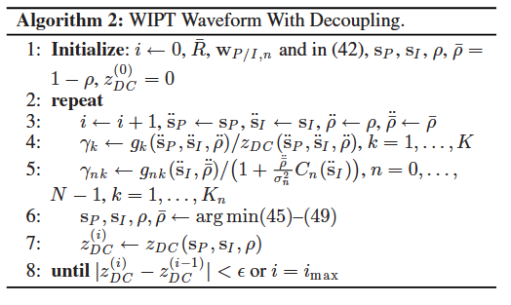
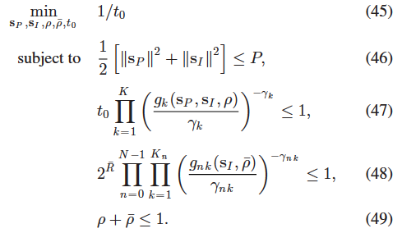
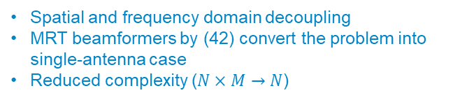
Algorithm: Multiple-Input
Waveform Optimisation for Information and Power Transfer
15 Feb. 19
Spatial and frequency domain decoupling
MRT beamformers by (42) convert the problem into single-antenna case
Reduced complexity ($N×M→N$)
B. Clerckx, “Wireless Information and Power Transfer: Nonlinearity, Waveform Design and Rate-Energy Tradeoff,” IEEE Trans. on Sig. Proc., vol 66, no 4, pp 847-862, Feb. 2018.

Slide 11
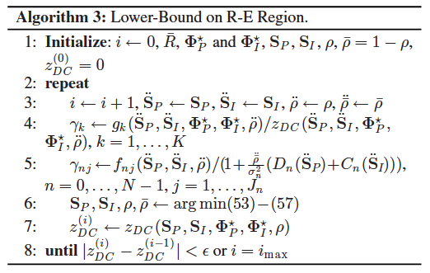
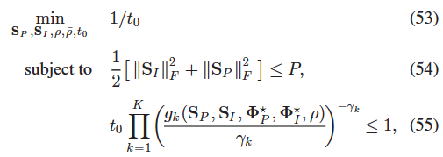
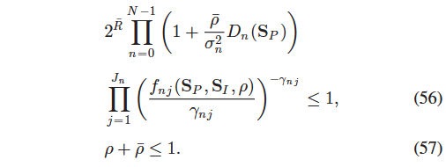
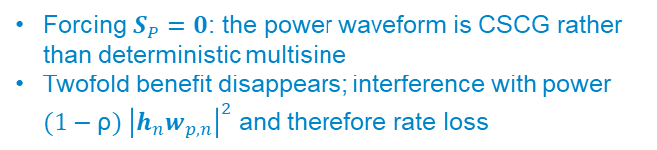
Algorithm: Lower-Bound
Waveform Optimisation for Information and Power Transfer
15 Feb. 19
Forcing $S_{P}=0$: the power waveform is CSCG rather than deterministic multisine
Twofold benefit disappears; interference with power $(1−\text{ρ}) {\left|h_{n}w_{p,n}\right|}^{2}$ and therefore rate loss
B. Clerckx, “Wireless Information and Power Transfer: Nonlinearity, Waveform Design and Rate-Energy Tradeoff,” IEEE Trans. on Sig. Proc., vol 66, no 4, pp 847-862, Feb. 2018.

Slide 12
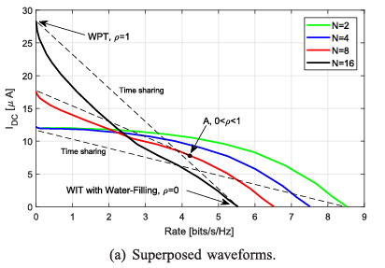
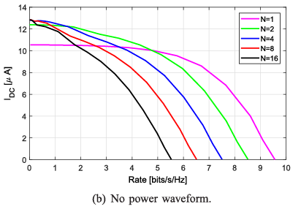
Result: Power Waveform
Waveform Optimisation for Information and Power Transfer
15 Feb. 19
R-E region as a function of $N$ for $M=1,B=1$ MHz and $SNR=20$ dB
B. Clerckx, “Wireless Information and Power Transfer: Nonlinearity, Waveform Design and Rate-Energy Tradeoff,” IEEE Trans. on Sig. Proc., vol 66, no 4, pp 847-862, Feb. 2018.

Slide 13
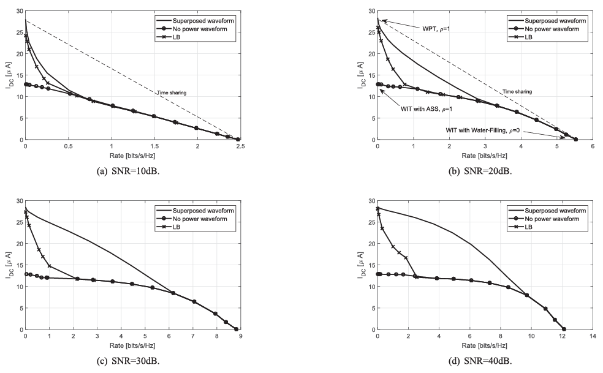
Waveform Optimisation for Information and Power Transfer
15 Feb. 19
R-E region for $N=16, M=1,B=1$ MHz and $SNR=10, 20, 30, 40$ dB
B. Clerckx, “Wireless Information and Power Transfer: Nonlinearity, Waveform Design and Rate-Energy Tradeoff,” IEEE Trans. on Sig. Proc., vol 66, no 4, pp 847-862, Feb. 2018.

Slide 14
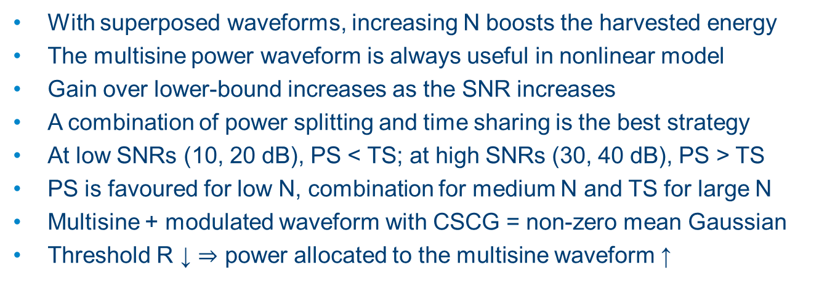
Analysis and Conclusions
Waveform Optimisation for Information and Power Transfer
15 Feb. 19
With superposed waveforms, increasing N boosts the harvested energy
The multisine power waveform is always useful in nonlinear model
Gain over lower-bound increases as the SNR increases
A combination of power splitting and time sharing is the best strategy
At low SNRs (10, 20 dB), PS < TS; at high SNRs (30, 40 dB), PS > TS
PS is favoured for low N, combination for medium N and TS for large N
Multisine + modulated waveform with CSCG = non-zero mean Gaussian
Threshold R ↓ $⇒$ power allocated to the multisine waveform ↑

Slide 15
Thank you!
Waveform Optimisation for Information and Power Transfer
15 Feb. 19

